Slide 1

Agenda
○ | SDM Digital Pharmacy App

Slide 2
SDM Digital Pharmacy App – Proposed Functionalities
Areas | Existing Functionality/Feature | Additional/Proposed Functionalities
Store Functionalities | Find nearest store | Store identification on the basis of searched products based, Store hours Manage and Transfer prescriptions to preferred store Bluetooth/ibeacon technology to push refill and fill reminders when in vicinity of store
Notifications | Schedule pharmacy refill reminders | Seasonal Notifications e.g. Flu Shots Improving Refill reminder notifications display, Pill reminder – Snooze functionality Recommendations about personalized health check up schedules
Additional Service |  | Health Dashboard - Health Monitor Applications – e.g. BMI, BP tracking Coupons based on buying behavior Mail order services – for old age people and chronic diseases like diabetes Health hazards, diet plans and Doctor Information
Ease of Use/ Convenience | Access personalized offers Create your own shopping list | Bar code / QR code scan to avoid entering multiple details Evaluation of immunization history and receive a recommendation Check Drug Interactions, Drug Information with recommended usage
Payments / Loyalty / Reward Points | Load coupons directly to Shoppers optimum Card Show digital Shoppers Optimum Card in-store Earn and spend Shoppers Optimum Points Check points balance and reward level Check flyer deals | Connect to health devices to earn redeemable points for achieving goals – sync with wearable smartwatch Bundling of complimentary products
Pharmacy |  | Scan to refill Manage Auto refill Refill for family prescriptions - Synchronizing family medicine pill boxes view rx status
Feedback/Help/ Customer Service |  | Pharmacy chat, manage mail service and text alerts Patient reviews and discussion forums
Additionally, Proposition for Hand Held Devices – mPOS – to reduce wait time

Slide 3
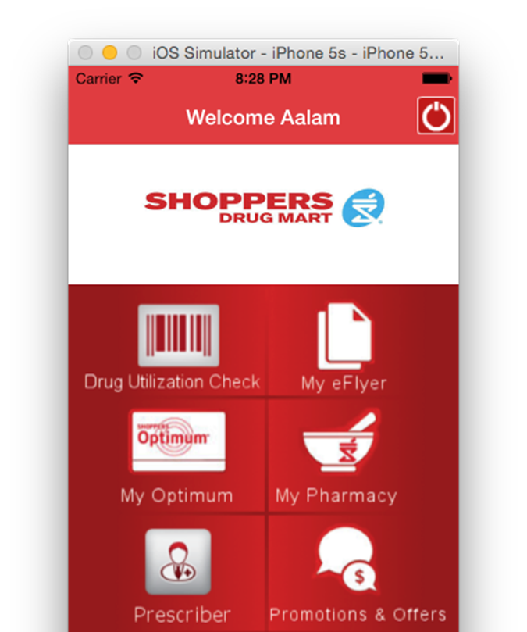
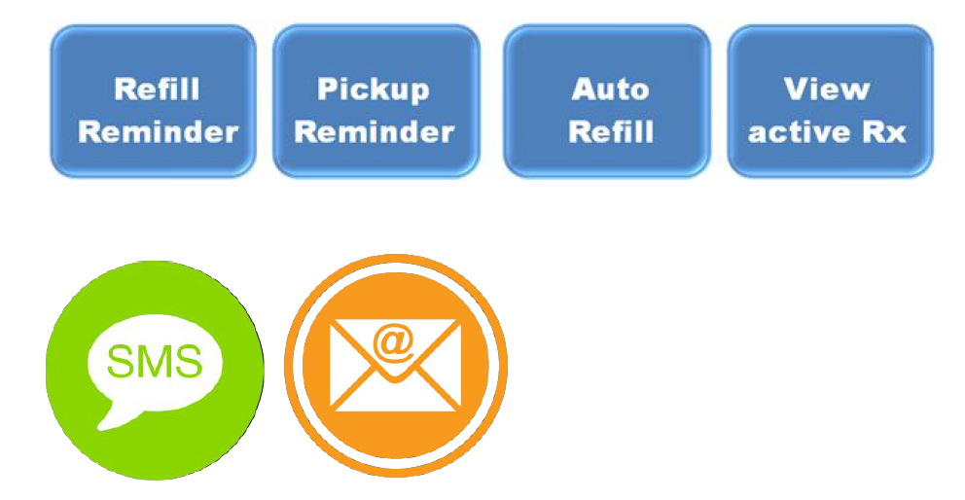
Shoppers Digital Landscape
Existing Mobile App Features
Access personalized offers
Load coupons directly to Shoppers optimum Card
Show digital Shoppers Optimum Card in-store
Earn and spend Shoppers Optimum Points
Check points balance and reward level
Check flyer deals
Order prescription refills
Schedule pharmacy refill reminders
Create your own shopping list
Find nearest store
LCL Digital Pharmacy Initiative Objectives
Phase 1 – Target 2016 Mid
Manage communication preferences
Signup to receive refill / pickup reminders and auto refill
Ability to view their active Rx’s
View/update profile
Access web services or interfaces on the smartphone within the mobile app
Later Phases – Target 2017-18
Integrate auto refill in to HW Delta
Pharmacy has visibility to patients who have signed up & update preferences, etc.
One patient view (i.e. each patient's individual store profile will remain as such)
Ability for customer to see Rx from more than one store in a single profile
Centralization of Rx data

